Slide 1


Coordination compounds with unusual coordination numbers
Al-Farabi Kazakh National University
Faculty of Chemistry and Chemical technology
Department of General and Inorganic Chemistry
PhD Bakhadur Askar

Slide 2



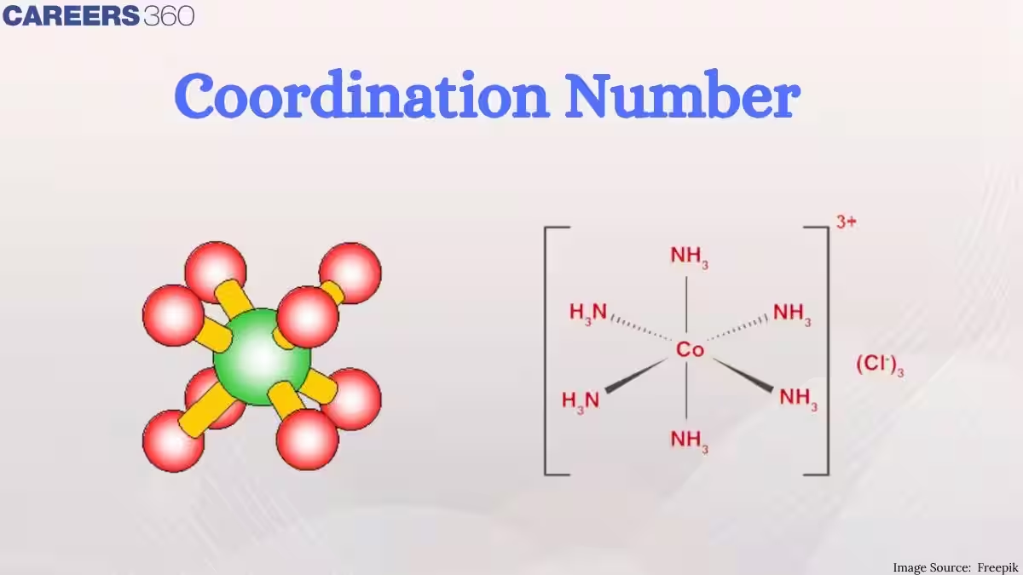
Coordination numbers
The coordination number (CN) is the number of ligand donor atoms directly bonded to the central metal ion in a coordination complex.
It reflects the geometry, electronic structure, and bonding capacity of the metal center.
Typical coordination numbers:
4 (tetrahedral, square planar)
6 (octahedral)
These geometries dominate in transition metal chemistry due to favorable spatial and electronic configurations.
However, unusual coordination numbers (below 4 or above 6) are also observed, especially in lanthanide, actinide, and sterically hindered transition metal complexes.

Slide 3
Low coordination numbers (CN = 2–3)
Low coordination numbers are common for:
d¹⁰ metals (Cu⁺, Ag⁺, Au⁺)
Bulky ligands preventing crowding
Examples:
[Ag(NH₃)₂]⁺ — Linear geometry, CN = 2.
[Cu(CN)₃]²⁻ — Trigonal planar geometry, CN = 3.
[Pt(PPh₃)₂] — Linear, stabilized by bulky phosphine ligands.
Characteristics:
Common in soft metal ions with filled d-orbitals.
Often stabilized in gas phase or nonpolar solvents.
Exhibit unique optical and catalytic properties.

Slide 4
High coordination numbers (CN = 7–12)
High coordination numbers appear in large metal ions or when small ligands (e.g., F⁻, CN⁻, H₂O) surround the metal.
Examples:
[ZrF₇]³⁻ → Pentagonal bipyramidal (CN = 7)
[Mo(CN)₈]⁴⁻ → Square antiprismatic (CN = 8)
[La(H₂O)₉]³⁺ → Tricapped trigonal prismatic (CN = 9)
[Ce(NO₃)₆]²⁻ → CN = 12
Reasons for stability:
Large ionic radii of lanthanides and actinides
High charge allowing dense packing of small ligands
Weak ligand–ligand repulsion

Slide 5
Factors affecting coordination number
1. Metal Ion Size
Larger metal ions can accommodate more ligands.
e.g., Lanthanides → CN up to 12
2. Electronic Configuration
d⁰ or f⁰ metals have less repulsion, allowing higher CN.
d¹⁰ systems often show lower CN due to filled orbitals.
3. Ligand Size and Donor Strength
Small ligands (F⁻, CN⁻, H₂O) favor high CN.
Bulky ligands (PPh₃, tBuNH₂) limit CN to 2–4.
4. Solvent and Crystal Packing
Coordination number may change in solution vs. solid state.
Example: [Co(H₂O)₆]²⁺ (aq) vs. [CoCl₄]²⁻ (solid).

Slide 6
Structural and electronic explanations
Unusual CNs are rationalized by:
Crystal Field Theory (CFT): Distribution of d-orbitals influences ligand arrangement.
Steric Effects: Bulky ligands restrict coordination sites.
Metal–Ligand Bond Energy: High CNs occur when bonding energy compensates repulsion.
Relativistic Effects: Heavy transition metals (Pt, Au) exhibit low CN due to contraction of 6s and 5d orbitals.
Hybridization:
  CN = 2 → sp
  CN = 4 → dsp² or sp³
  CN = 6 → d²sp³
  CN > 6 → involvement of f-orbitals (especially in lanthanides/actinides).

Slide 7
Key points
Coordination number defines the number of ligand atoms bonded to the central metal.
Typical CN values are 4 and 6, but unusual numbers (2–3, 7–12) occur under special conditions.
Low CN → small, soft metals with bulky ligands.
High CN → large, highly charged metals with small ligands.
Determined by ionic size, electronic structure, ligand sterics, and solvent environment.
Unusual coordination numbers expand our understanding of chemical bonding, catalysis, and material design.

Slide 8
Thank you for attention!

